Slide 1



RECOMMENDATION SYSEM
DATAQUEST
Presented by: Lalelani Eddie Nene

Slide 2

OVERVIEW
01
02
03
Probelm Statement
Data Analysis
Business Value
04
05
06
Quarter
Next Project
Strategy

Slide 3






PROBLEM STATEMENT
The existing recommendation system fails to prioritize customer needs by not adequately considering their personal preferences and interests. This oversight results in significant customer dissatisfaction and reduced engagement. Consequently, it diminishes the overall lifetime value of our customer relationships, impacting long-term loyalty and revenue growth. To enhance customer experience and maximize the lifetime value, it is crucial to develop a recommendation system that accurately reflects individual customer preferences and delivers personalized, relevant solutions.

Slide 4

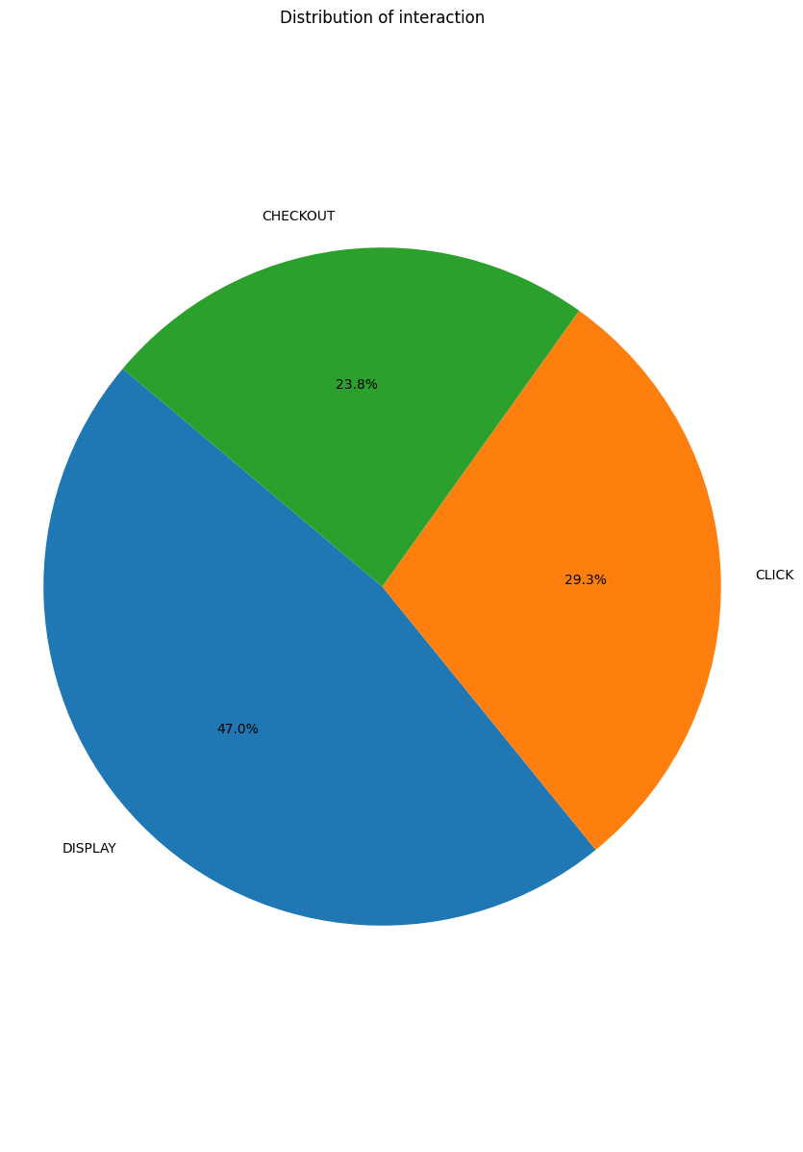
User-Interaction Analysis

Slide 5
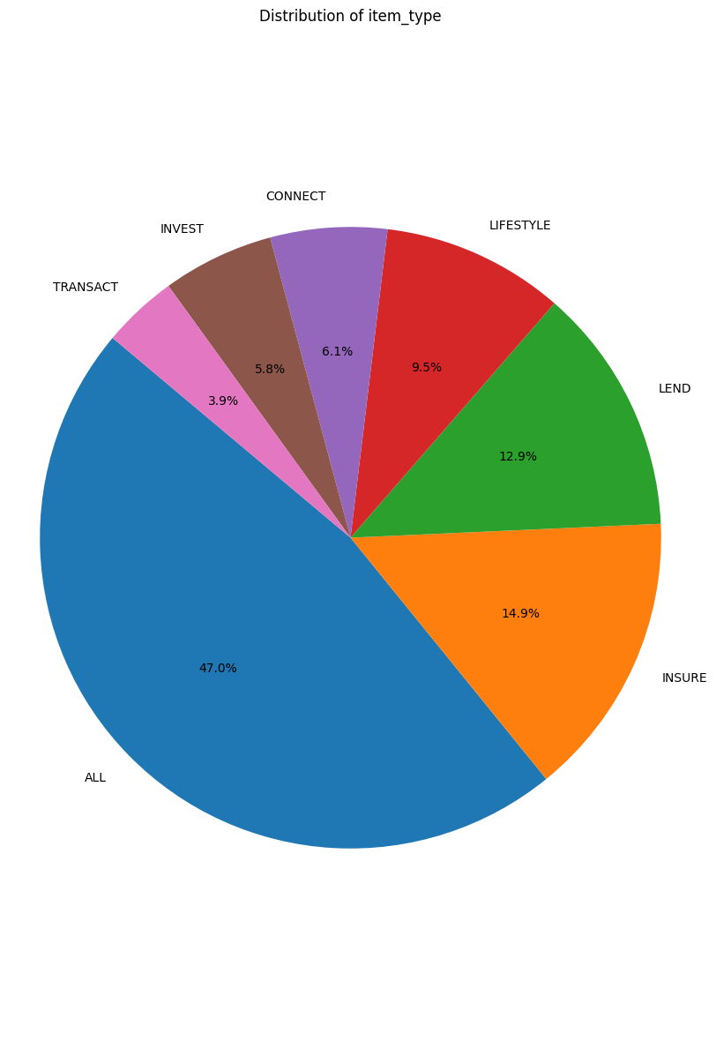
User -Service Ranked Analysis

Slide 6



STATISTICS ON A DASH BOARD
80
20%

